Slide 1
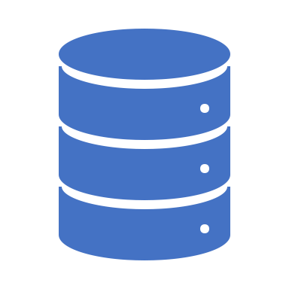
Data Warehouse for Online Retail Database
INFSCI 2711 – Spring 2020

Slide 2
Online Retail Database
This Online Retail II data set (the original dataset is a excel file) contains all the transactions occurring for a UK-based and registered, non-store online retail between 01/12/2009 (1st Dec 2009) and 09/12/2011 (9th Dec 2011). The company mainly sells unique all-occasion giftware. Many customers of the company are wholesalers.

Slide 3
Data Description
The dataset has the following attributes:
InvoiceNo: Invoice number. Nominal. A 6-digit integral number uniquely assigned to each transaction. If this code starts with the letter 'c', it indicates a cancellation.
StockCode: Product (item) code. Nominal. A 5-digit integral number uniquely assigned to each distinct product.
Description: Product (item) name. Nominal.
Quantity: The quantities of each product (item) per transaction. Numeric.
InvoiceDate: Invoice date and time. Numeric. The date and time when a transaction was generated.
UnitPrice: Unit price. Numeric. Product price per unit in sterling (Â£).
CustomerID: Customer number. Nominal. A 5-digit integral number uniquely assigned to each customer.
Country: Country name. Nominal. The name of the country where a customer resides.

Slide 4
Data Cleaning
Following are the initial set of steps to clean the data manually:
Removed records with blank CustomerIDs and unsual stockcodes
Removed zero Price items.
Removed “Unspecified” country records.
Changed Negative quantity records to positive quantity values.
Separate Datetime into Date and Time columns.
Calculated Subtotal for each record.

Slide 5



Choices of Database
SQL Database
NoSQL Database

Slide 6
System Structure
Frontend
Backend
DBs

Slide 7
System Assumptions
An item can have multiple descriptions for the same StockCode.
We are assuming that a top product is the product that is most quantity purchased by the customer.
We are assuming that the currency is the same across all the countries.

Slide 8
Aggregate Queries
What time of the day (which hour of the day) is the sale maximum per country?
What is the annual TotalSales per product?
What is the top product per year?
What is the top product per country?
Which item is sold below a certain threshold value? Or, what are the under-performed products based on the average sales last year (the year denotes either 2009 or 2010)?
Which customer spends the most (per country/overall)?
What is the best-selling month per country? (Given the year range, 2009-2011)
What is the best-selling product per month? (Given the year range, 2009-2011)
What is the change in TotalSales per country per year (Trend of Sales)?
What is the average spending of a customer per country? (TotalSales/Number of customers)
What is the frequently purchased item per customer?

Slide 9
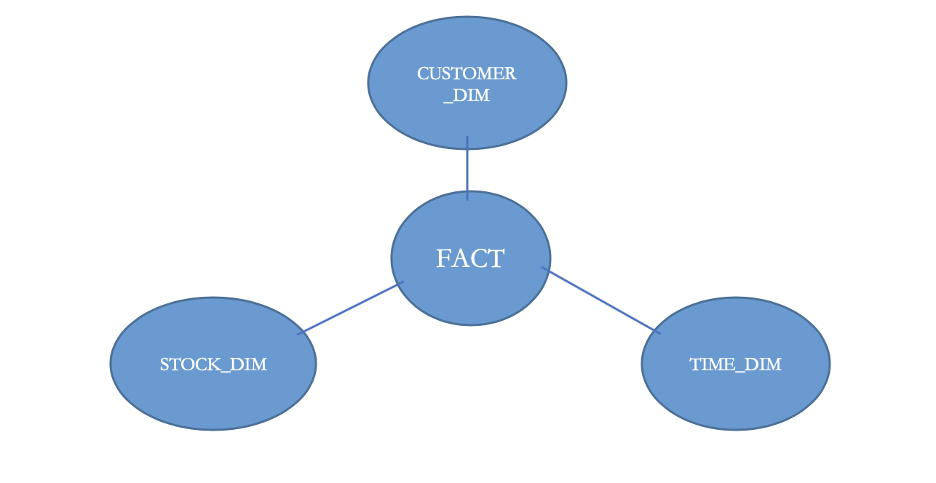
Star Schema
Dimensions:
CUSTOMER_DIM (CustomerID, Country)
STOCK_DIM (StockCode, Description, UnitPrice)
TIME_DIM (Year, Month, Day, Hour, Minute)
Measures:
Quantity – Quantity Sold
Total Sales – Quantity * Unit price
FACT TABLE:
FACT (CustomerID, Year, Month, Day, Hour, Minute, StockCode, Quantity, TotalSales)

Slide 10
MySQL Implementation
Aishwarya Jakka
Shruti Gupta

Slide 11

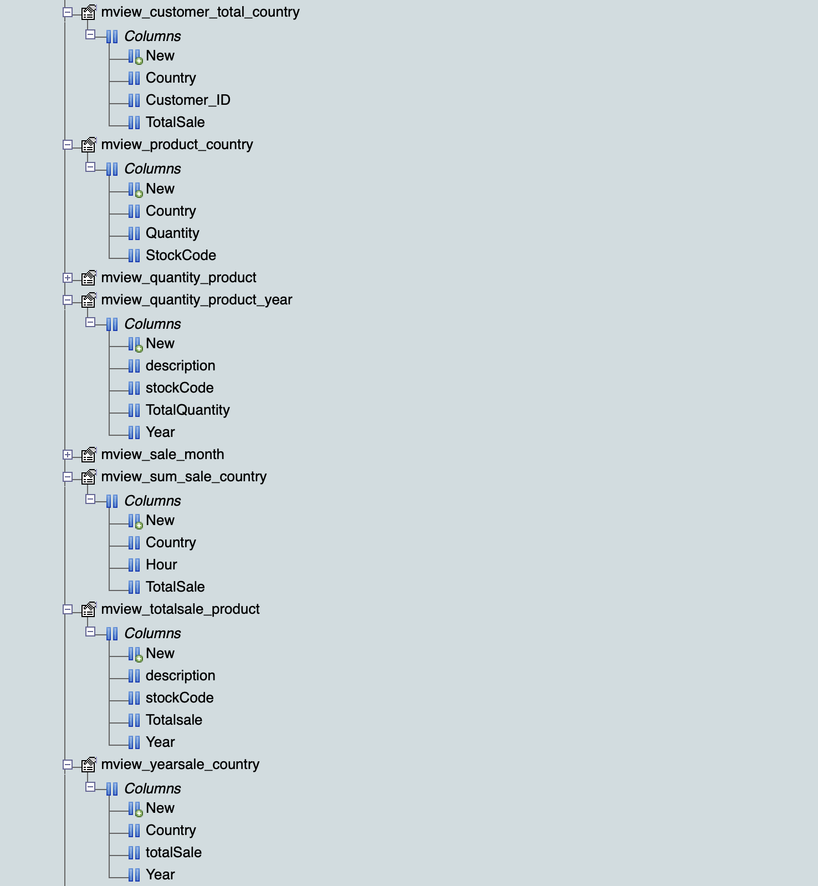
SQL Optimization
View Materialization

Slide 12
SQL Advantages and Disadvantages
Advantages | Disadvantages
It is designed for structured data | Cannot be used in unstructured data
Each row of one column should be of same data type | If any row of a column have different data type, it fails to load data
Every Query was executed using Joins | Takes a lot of time in loading large amount of data
Can create view and view materialization to speed up the execution time It holds ACID properties | The time it took to run join queries ranged from 4 min to 8 min

Slide 13
MongoDB Implementation
Piu Mallick
Reshma Pothen

Slide 14
Challenges of MongoDB
It has a steep learning curve.
The main challenge in ODB database was to split the InvoiceDate and InvoiceTime into individual Year, Month, Day, Hour, Minute (as the Date and Time were already split in the initial part of the data cleaning). Hence, we imported the csv file to Python to do the date and time splitting.
Learning about memory utilization in mongodb in various stages and how indexes plays their part on that was key to faster query execution. Without creating an index for the ‘Stock_Dim’ collection, for instance, several queries would have taken far longer to execute.
For queries 4, 6, 7, 8, 9, 10 and 11, we set the ‘allowDiskUse’ parameter to true. This enables writing to temporary files. When set to true, most aggregation stages can write data to the _tmp subdirectory in the dbPath directory.

Slide 15
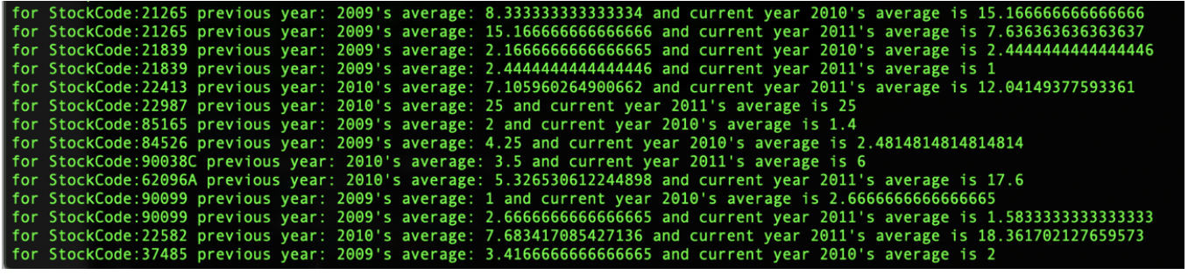
Query 5: Which item is sold below the threshold value? Or, what are the under-performed products based on the average sales last year (the year denotes either 2009 or 2010)?

Slide 16
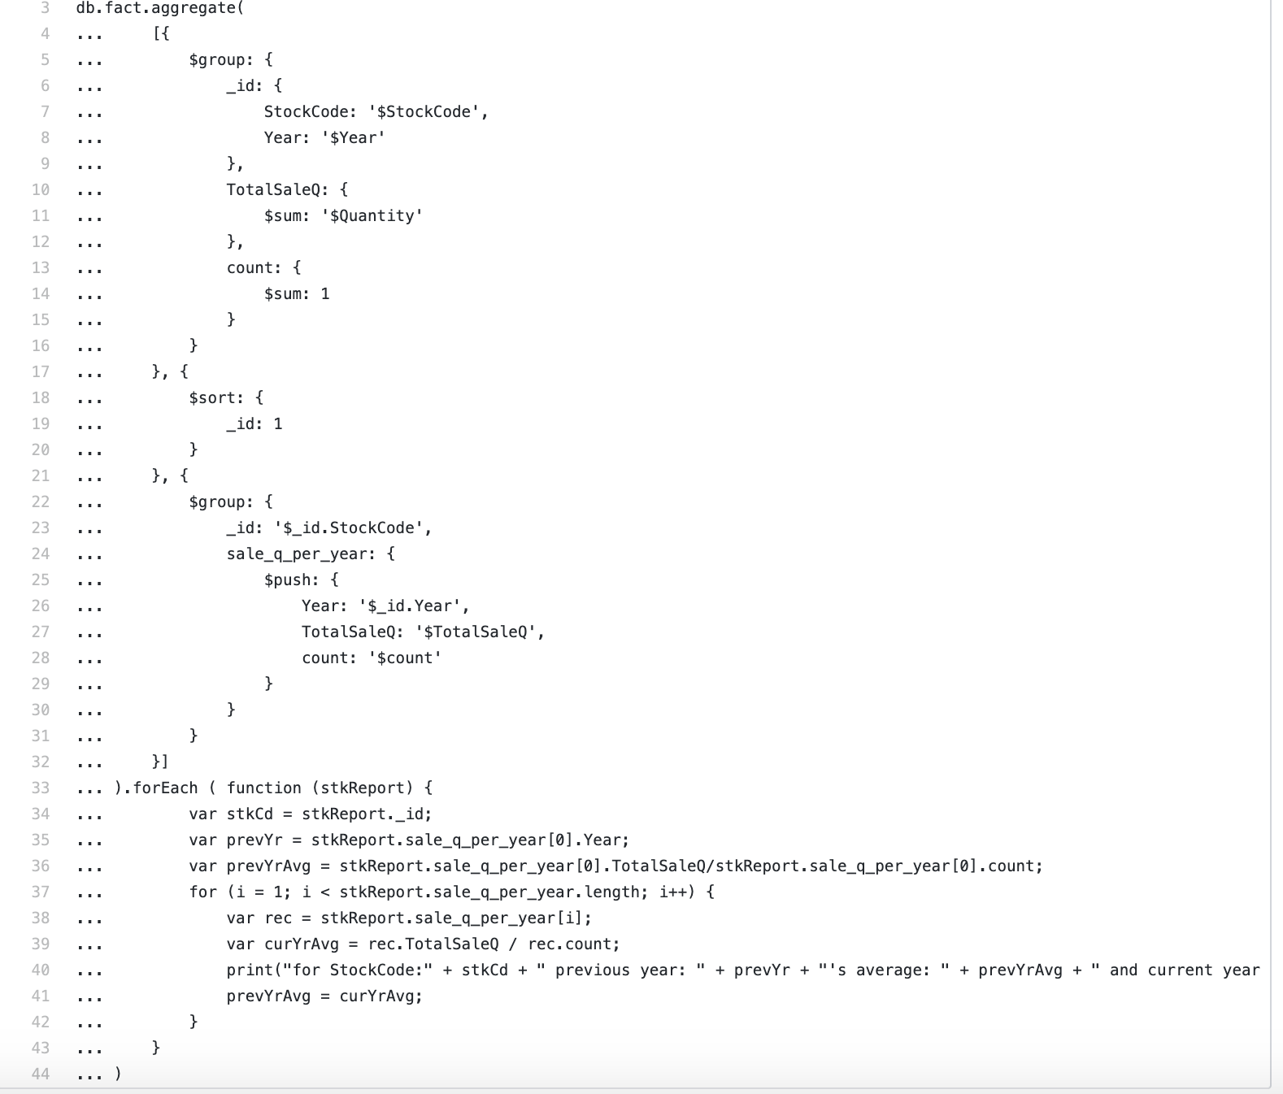
Sample Code

Slide 17
MongoDB Advantages and Disadvantages
Advantages
Disadvantages
MongoDB can very quickly query and return results from very large data sets. Insertion of over 700,000 records took relatively minimal time.
While Relational Databases would require views to speedup query execution, this was not required for MongoDB.
While sending data to the User Interface (UI), we are spared from doing further transformation of data in MongoDB.
Multiple joins(lookup) is not advisable in MongoDB as it is meant to be a database where data needs to be denormalized as much as possible.
In MongoDB, the methods available in an aggregation stage or in a find operation and their behavior is limited and quite rigid.
Since the output of MongoDB is in JSON format, there are limits on the operation and calculations that can be achieved using only MongoDB scripts. For example, the queries #5 and #9 required extensive calculation on the output of the aggregation which was not possible only through MongoDB scripts. So, some of it was delegated to the caller function.

Slide 18

Neo4j Implementation
Soham Bhatnagar
Aishwarya Jakka
Kenny Wu
Kwesi Aguillera
Notes:
We had more cleaning so that InvoiceDate and InvoiceTime in the ODB are understood by Neo4j
We also created relations between the "Tables" in the ADB for "Joining" the tables

Slide 19
Changes to the Star Schema
We have added TimeID to the FACT table and the TIMEDIM table.
This has been done as Neo4j does not handle the creation of a relation using multiple properties.
Without TimeID, the query would run for 6+ hours if the dbms.memory.heap.max_size configuration is changed from 1GB to 10GB in the config file.
This was unacceptable and for the query to run in a timely manner we added TimeID.
The TimeID property is not used in anything except the creation of the relation between the FACT table and the TIMEDIM table

Slide 20
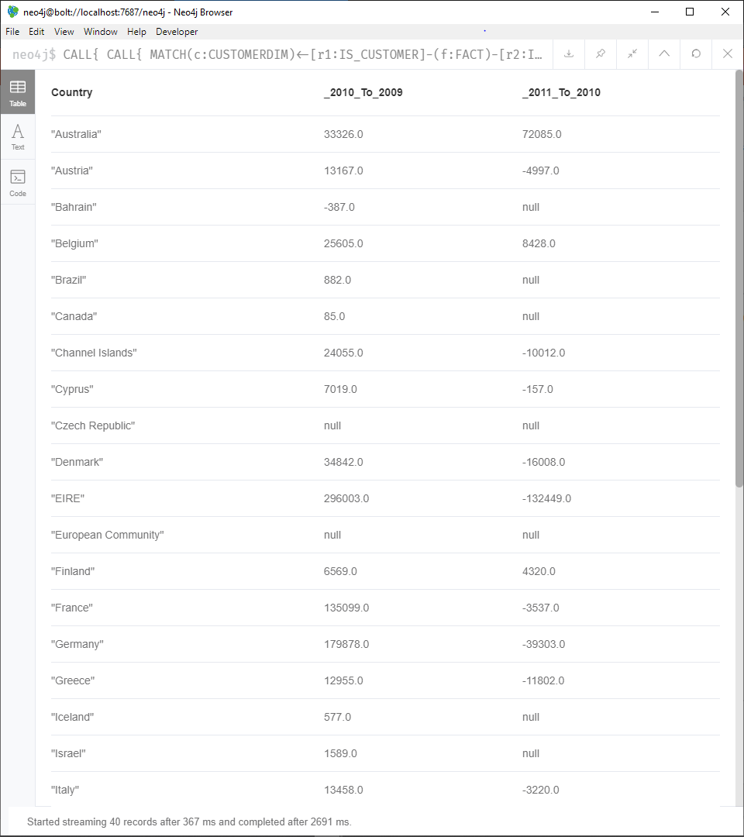
Query 9: What is the change in total sales per country per year
Query:
CALL{ CALL{ MATCH(c:CUSTOMERDIM)<-[r1:IS_CUSTOMER]-(f:FACT)-[r2:IS_STOCK]->(s:STOCKDIM) WITH [SUM(f.TotalSales), f.Year, c.Country] AS Top_Prod
RETURN Top_Prod[1] AS Year, Top_Prod[2] AS Country, SUM(Top_Prod[0]) AS TotalSales ORDER BY Year}
RETURN collect(Year) AS Year, Country, collect(TotalSales) AS TotalSales }
RETURN Country, ROUND(TotalSales[1]-TotalSales[0]) AS _2010_To_2009, ROUND(TotalSales[2]-TotalSales[1]) AS _2011_To_2010 ORDER BY Country
Why it doesn't work
In the current form the query does not distinguish between the different years
For it to work we need a WHERE condition which is not possible after a CALL function.
Notes:
This is not possible as there is no WHERE clause In CALL function
This problem also exists for Query 5 in Neo4j

Slide 21
Neo4j Advantages and Disadvantages
Advantages
Disadvantages
By creating relationships between the nodes and effectively converting out database into a graph, thus we are avoiding the need to define joins in the query saving time.
Neo4j is databases do not have a structure and hence is very flexible in terms if changes to the database structure.
Because each node does not need to have a structure neo4j can deal with missing data or when there is no definite number of entries in the table. E.g. when the users keep adding phone numbers
There are no nested aggregations in a straightforward manner they must be done using the CALL function
Cloning nodes is a very slow process and must be done using the APOC plugin for many entries
Creating Relationships between nodes using multiple properties is a very slow and memory intensive process
The CALL function does not allow any additional conditional filters

Slide 22
Comparison between 3 databases
Notable Features | Databases
 | SQL DB | Mongo DB | Neo4j
Data Loading | Data loading took time | Has 'mongoimport' functionality that loaded data quite fast | Has automated batch loading
Large Data Handling | A relational database is very inflexible for large databases due to ACID | Handles large data of any kind very well. | Vertical data is not handled well, Horizontal data is handled well
Joining Tables/Collections/Nodes | Required | Possible using lookups, but not recommended. | Permanent Relationships between nodes
Index Creation | Not implemented due to resource constraints | While not required, is encouraged for faster execution when data is retrieved from more than 1 collection. | Not required but single and composite indexes can be created on node properties
View Materialization | Required | Not required | Not required
Query Execution Speed | Slow without view materialization | With indices in place, queries execute quite fast – in the order of a few seconds | Fast, but only for horizontally large data.
Notes:
SQL database experienced a lot of difficulties while doing bulk import where as in MongoDB and Neo4j it was possible with a simple command/import function.
View materialization is beneficial for SQL database has it allows ijn speeding up query execution but in MongoDB and Neo4j, it was not required -

Slide 23
Comparison between 3 databases
Notable Features | Databases
 | SQL DB | Mongo DB | Neo4j
Data Loading | Data loading took time | Has 'mongoimport' functionality that loaded data quite fast | Has automated batch loading
Large Data Handling | A relational database is very constrained for large databases due to ACID | Handles large data of any kind very well. | Vertical data is not handled well, Horizontal data is handled well
Joining Tables/Collections/Nodes | Required | Possible using lookups, but not recommended. | Permanent Relationships between nodes
Index Creation | Not implemented due to resource constraints | While not required, is encouraged for faster execution when data is retrieved from more than 1 collection. | Not required but single and composite indexes can be created on node properties
View Materialization | Required | Not required | Not required
Query Execution Speed | Slow without view materialization | With indices in place, queries execute quite fast – in the order of a few seconds | Fast, but only for horizontally large data.
Notes:
SQL database experienced a lot of difficulties while doing bulk import where as in MongoDB and Neo4j it was possible with a simple command/import function.
View materialization is benefiticial for SQL database has it allows ijn speeding up query execution but in MongoDB and Neo4j, it was not required -

Slide 24
Demo

Slide 25
Subgroups and Responsibilities
Coordinator
Aishwarya Jakka
MongoDB
Piu Mallick
Reshma Pothen
Soham Bhatnagar
Neo4j
Aishwarya Jakka
Front End-Backend Integration
Kenny Wu
Kwesi Aguillera
Documentation
Kwesi Aguillera
Kenny Wu
Shruti Gupta
Piu Mallick
Reshma Pothen
Aishwarya Jakka
Shruti Gupta
SQL

Slide 26
Thank you

